Slide 1
Part 3a:
Understanding Inclusive Design
Marcelo Paiva (30min)

Slide 2
Design focus over the years in the United States
Inclusion
20%
The Marginalized Sub-groups
Accessibility
Crowd & Sharing Economy
80%
The Privileged Groups
E-commerce
& Social
Information Overload
Connecting
90s - Web
Early 2000s
Late 2000s
Early 2010s
Late 2010s
now on

Slide 3
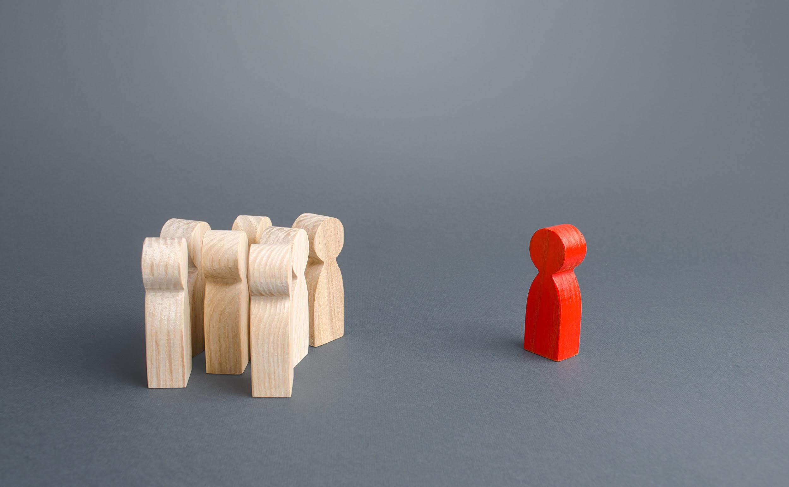

Have you ever felt left out?
Photo by @ilixe48 on Freepik

Slide 4
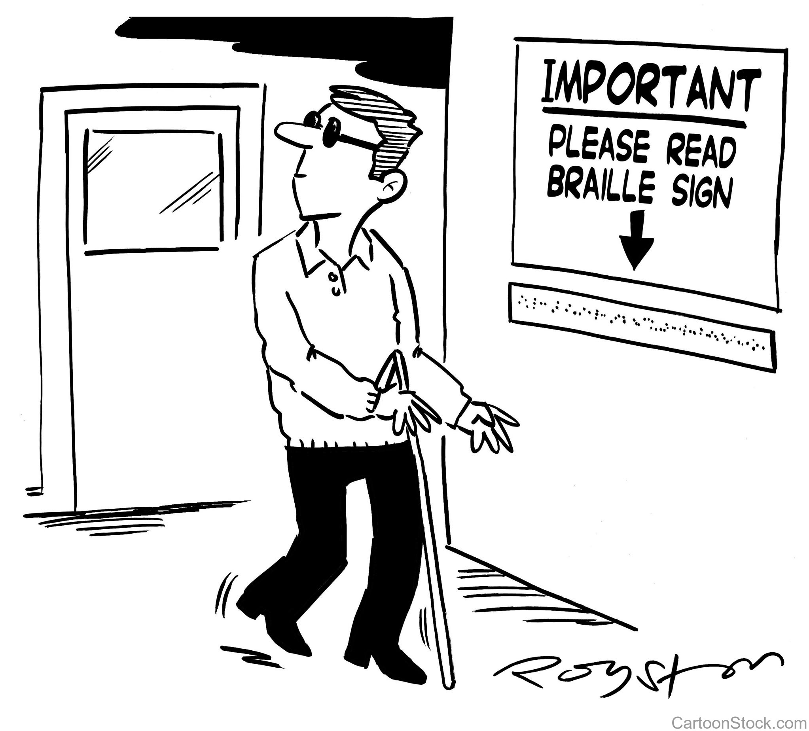
Illustration © Royston Robertson

Slide 5
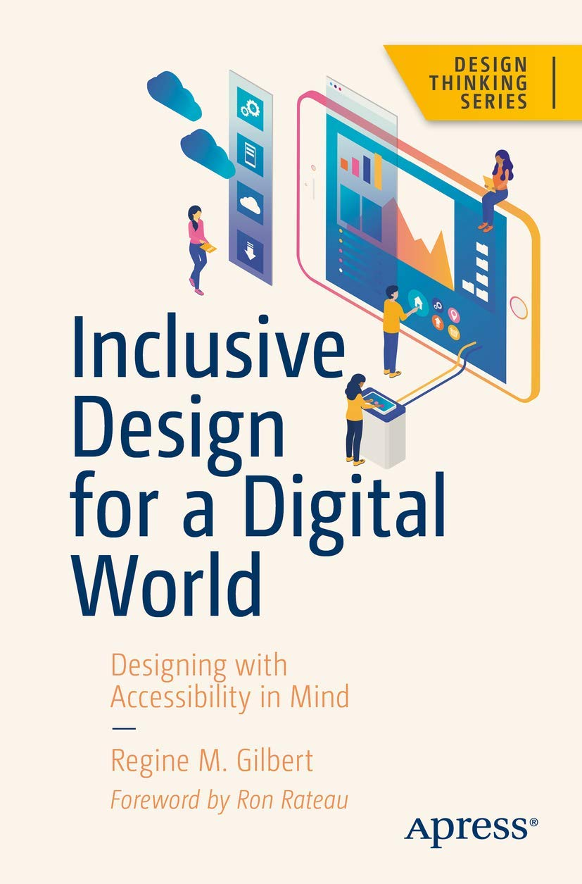


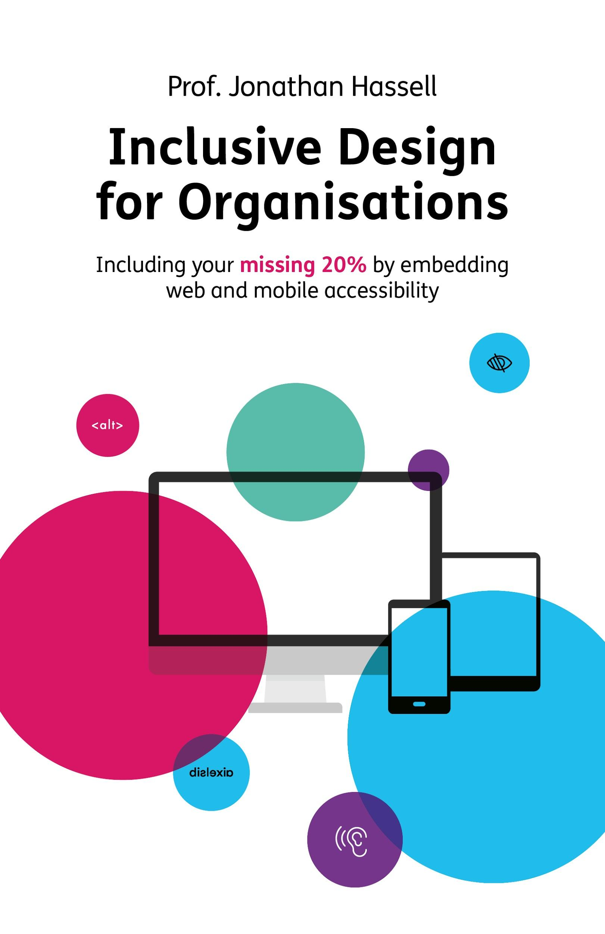
Results of my study based on:
Inclusive Design for a Digital World
Regine M. Gilbert
Mismatch
How Inclusion Shapes Design
Kat Holmes
A Web for Everyone
Designing Accessible UX
Horton, Quesenbery
Inclusive Design for Organisations
Jonathan Hassell

Slide 6
Inclusive Design for a Digital World
When we create products and experiences that are not inclusive and accessible, there is the possibility we are leaving folks with the feeling of being left out of experiences.

Slide 7
Universal Design is the design of buildings, products or environments to make them accessible to all people, regardless of age, disability or other factors.

Slide 8
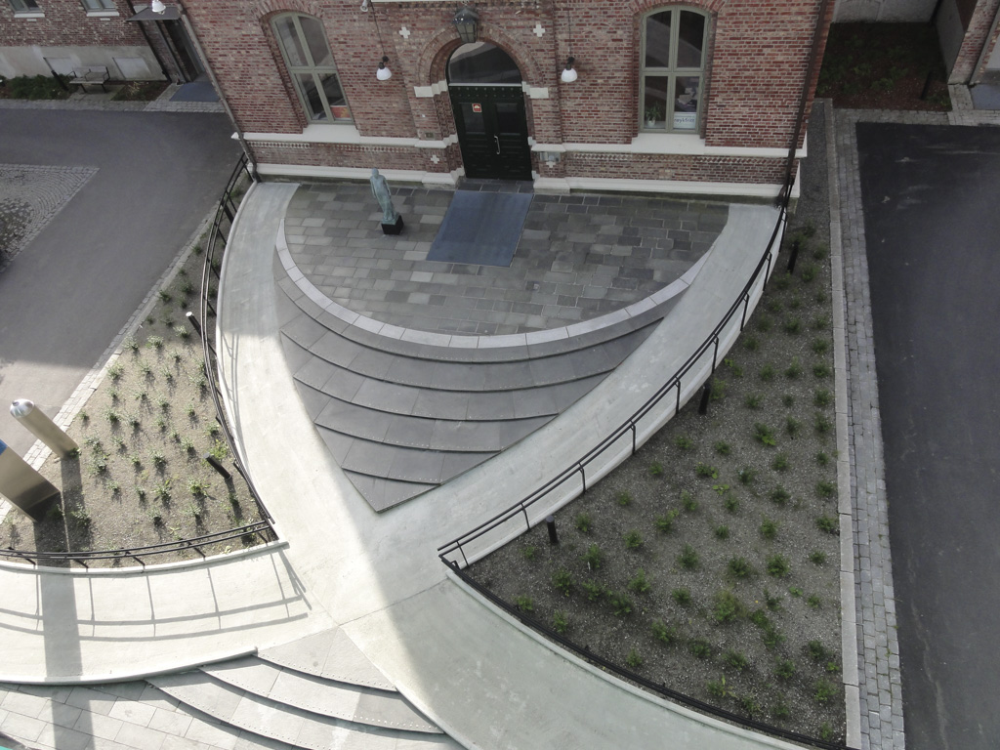
Universal Design example:
Photo displays the entrance to one of the buildings at St. Olav’s Hospital, in Norway.
Two wheelchair circular ramps originate from each side of the sidewalk towards the entrance of the building, crossing each other, leaving the stairway steps in the middle filling the intersection left by the ramps.
The design that is both functional and beautiful.

Slide 9
Universal Design example:
Photo displays the entrance to one of the buildings at St. Olav’s Hospital, in Norway.
Two wheelchair circular ramps originate from each side of the sidewalk towards the entrance of the building, crossing each other, leaving the stairway steps in the middle filling the intersection left by the ramps.
The design that is both functional and beautiful.

Slide 10
Digital Experiences
Post-Pandemic

Slide 11

Healthcare
Photo by Anna Shvets from Pexels
Notes:
Recent experiences taught us that digital spaces are needed and is the future. Digital divide.

Slide 12

Education
Photo by August de Richelieu from Pexels
Notes:
Recent experiences taught us that digital spaces are needed and is the future. Digital divide.

Slide 13

Finance
Photo by Liza Summer from Pexels
Notes:
Claudio: you’re only as good as the weakest link in your digital chain

Slide 14
Digital Universal Design
How might we apply its principles to digital experiences?

Slide 15
7 Principles of Universal Design 1: Equitable Use
2: Flexibility in Use
3: Simple and Intuitive Use
4: Perceptible Information
5: Tolerance for Error
6: Low Physical Effort
7: Size and Space for Approach and Use

Slide 16
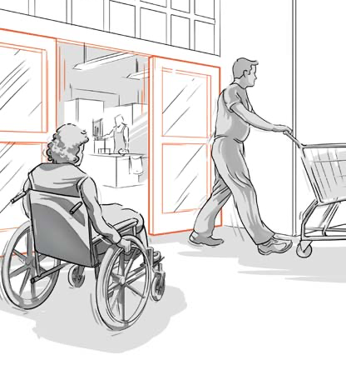
1: Equitable Use
The design is useful and marketable to people with diverse abilities
Digital Product Design includes:
Enough color contrast
Descriptive icons
Proper form labels and translation
In the picture powered doors that close and open on sensors can be used both by a wheelchair user and by someone that has their hands full.
Illustrations Center for Universal Design - North Carolina State

Slide 17
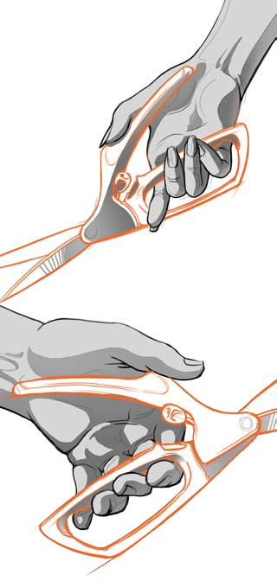
2: Flexible in Use
In the picture, a pair of scissor with a large grip handles can be used by any one whether he is left or right handed without any inconvenience.
The design accommodates a wide range of individual preferences and abilities.
Digital Product Design includes:
Proper heading styles
Ability to zoom in/out
No autoplay for audio and video
Illustrations Center for Universal Design - North Carolina State

Slide 18
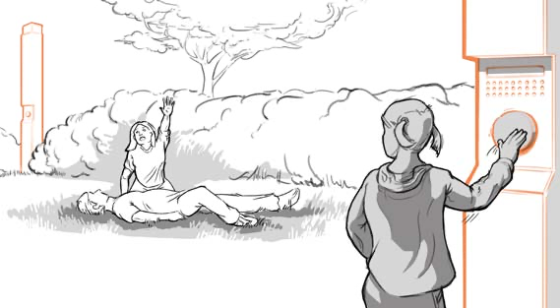
3: Simple and Intuitive Use
Use of the design is easy to understand, regardless of the user's experience, knowledge, language skills, or current concentration level.
Digital Product Design includes:
In the picture, the fire alarm uses a push button that is standard and color red. Even a child can understand that it is a panic button.
Visible focus
Minimum cognitive load
Less is more
Illustrations Center for Universal Design - North Carolina State

Slide 19
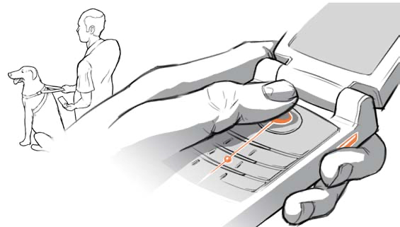
4: Perceptible Information
The design communicates necessary information effectively to the user, regardless of ambient conditions or the user's sensory abilities.
Digital Product Design includes:
Proper information architecture
Wayfinding: tab and focus order
Enough white space between content blocks
In the picture above a blind individual can use the cellphone keypad because of the bump on the pad that will enable the user without looking at the keypad.
Illustrations Center for Universal Design - North Carolina State

Slide 20
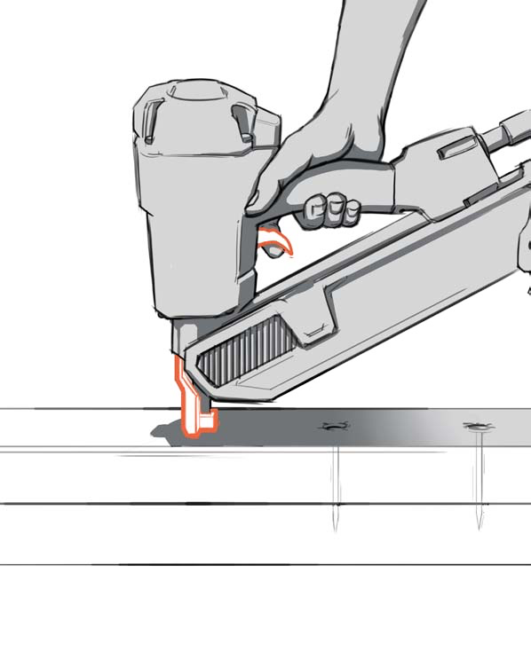
5: Tolerance for Error
The design minimizes hazards and the adverse consequences of accidental or unintended actions.
2
1
Digital Product Design includes:
Undo, redo
Error messages near the related elements
No keyboard trapping
In the picture a nail gun requires a to activate the safety release before pulling the trigger thereby removing the risk of accidents while the gun is pointed somewhere else.
Illustrations Center for Universal Design - North Carolina State

Slide 21
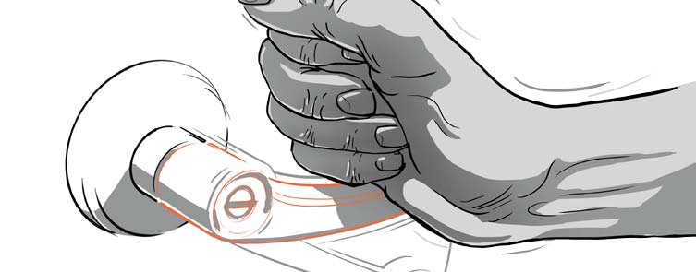
6: Low Physical Effort
The design can be used efficiently and comfortably and with a minimum of fatigue.
Digital Product Design includes:
In the picture a door knob is presented that does not require grip strength. A close fist or an elbow can open the door.
No unnecessary 'required' information
Succinct and objective instructions
Large target areas for pointing devices, and more.
Illustrations Center for Universal Design - North Carolina State

Slide 22
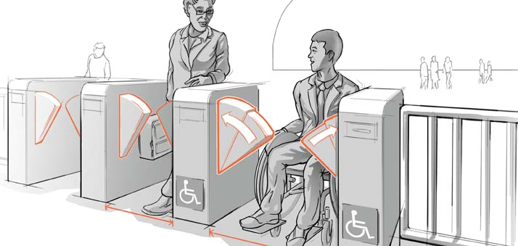
7: Size and Space for Approach and Use
Appropriate size and space is provided for approach, reach, manipulation, and use regardless of user's body size, posture, or mobility.
Digital Product Design includes:
In the picture subway gates are easily accessible by a person in a wheelchair or with a person carrying huge baggage or even with an obese commuter.
No modal windows blocking the entry points
Thoughtful skip-links
Large target areas for pointing devices, and more.
Illustrations Center for Universal Design - North Carolina State

Slide 23
Rethinking Accessibility
A new mental model for comprehending disabilities

Slide 24

Chapter 4:
Ability Biases and Mismatched Interactions
Kat Holmes
Author, Mismatch - How Inclusion Shapes Design

Slide 25
Chapter 4: Ability Biases and Mismatched Interactions
"We are all born and gain abilities as we grow.
As we move through life, our abilities change as result of a illness or environment."
Kat Holmes
Author, Mismatch - How Inclusion Shapes Design

Slide 26
A person's capabilities and limitations are always a factor in how successful they interact with a solution."
Kat Holmes
Author, Mismatch - How Inclusion Shapes Design

Slide 27
Disability is not
A personal health condition
Kat Holmes
Author, Mismatch - How Inclusion Shapes Design

Slide 28
Disability is a
Mismatched Human Interaction
Kat Holmes
Author, Mismatch - How Inclusion Shapes Design

Slide 29
Microsoft Inclusive Product Innovation
Exclusion happens when we solve problems using our own biases
Microsoft inclusive Design Toolkit
https://www.microsoft.com/design/inclusive/

Slide 30
Accessibility by Design
Creating accessible experiences beyond compliance

Slide 31
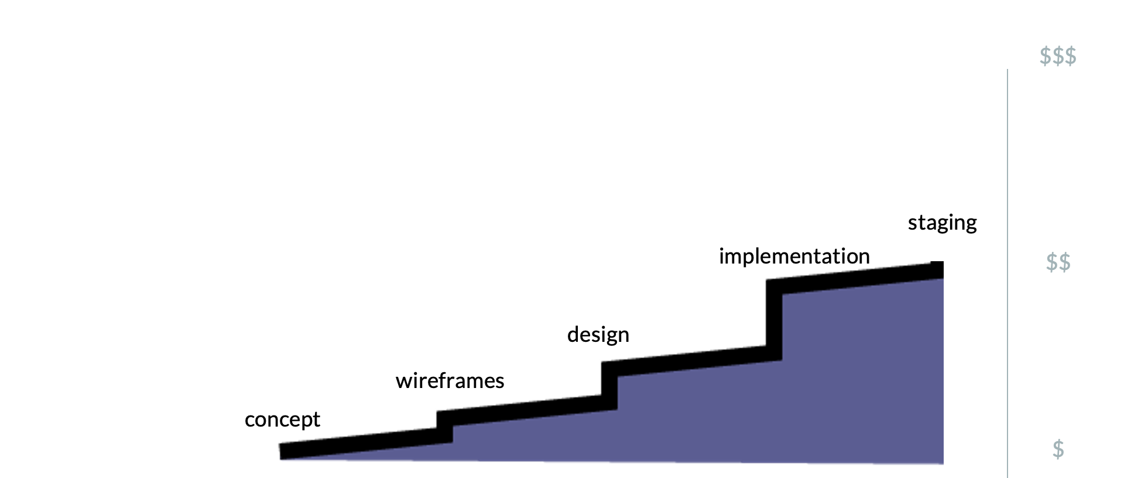
How does timing impact cost?
Efficient organizations fix accessibility issues before release

Slide 32
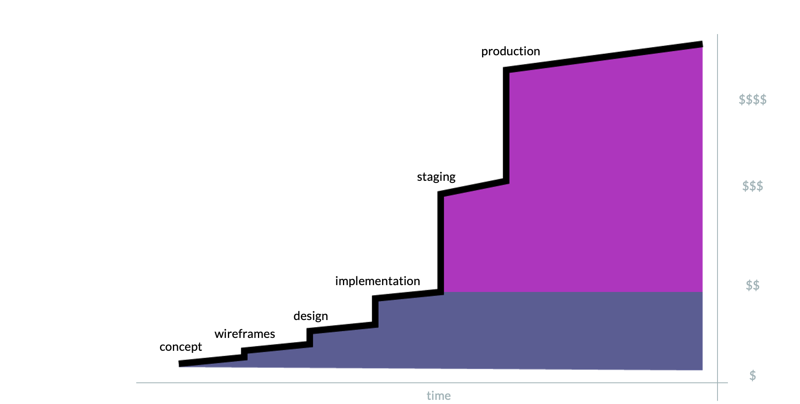
How does timing impact cost?
Companies that are new to accessibility must fix live releases

Slide 33
How does timing impact cost?
Companies that are new to accessibility must fix live releases
WASTE

Slide 34
<< Shift Left
How might we bring Accessibility early in the product life cycle, so we craft more inclusive experiences?

Slide 35
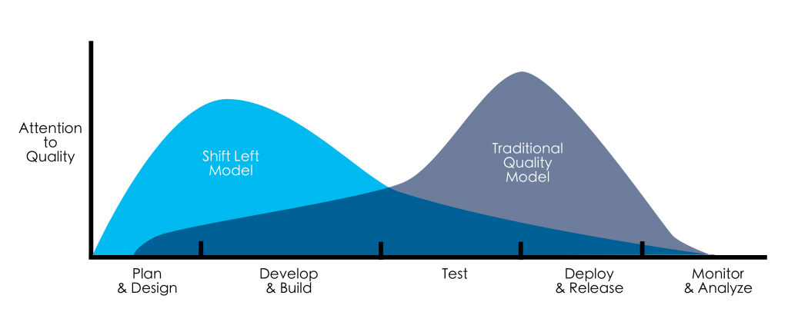
Shift Left
Include accessibility at the beginning of your design/build process

Slide 36
Accessibility as People First
Accessibility by Design
Idea
Research
Design
Develop
Test
Deploy
Set a Clear Purpose
Do not assume that people with disabilities are only a compliance check.
Inclusive User Personas
with diverse levels of disabilities and inclusion.
Design with Intent
Content design is crucial for assistive technologies
Inclusive
User Stories
Help promoting accessible patterns and experiences
Automation is not enough
QA's burden decreases as teams understand a11y
Check, Measure and Automate
Add Accessibility fences into pipelines and workflows

Slide 37
Inclusive Design
for professionals creating digital experiences
Notes:
give credit to Microsoft

Slide 38
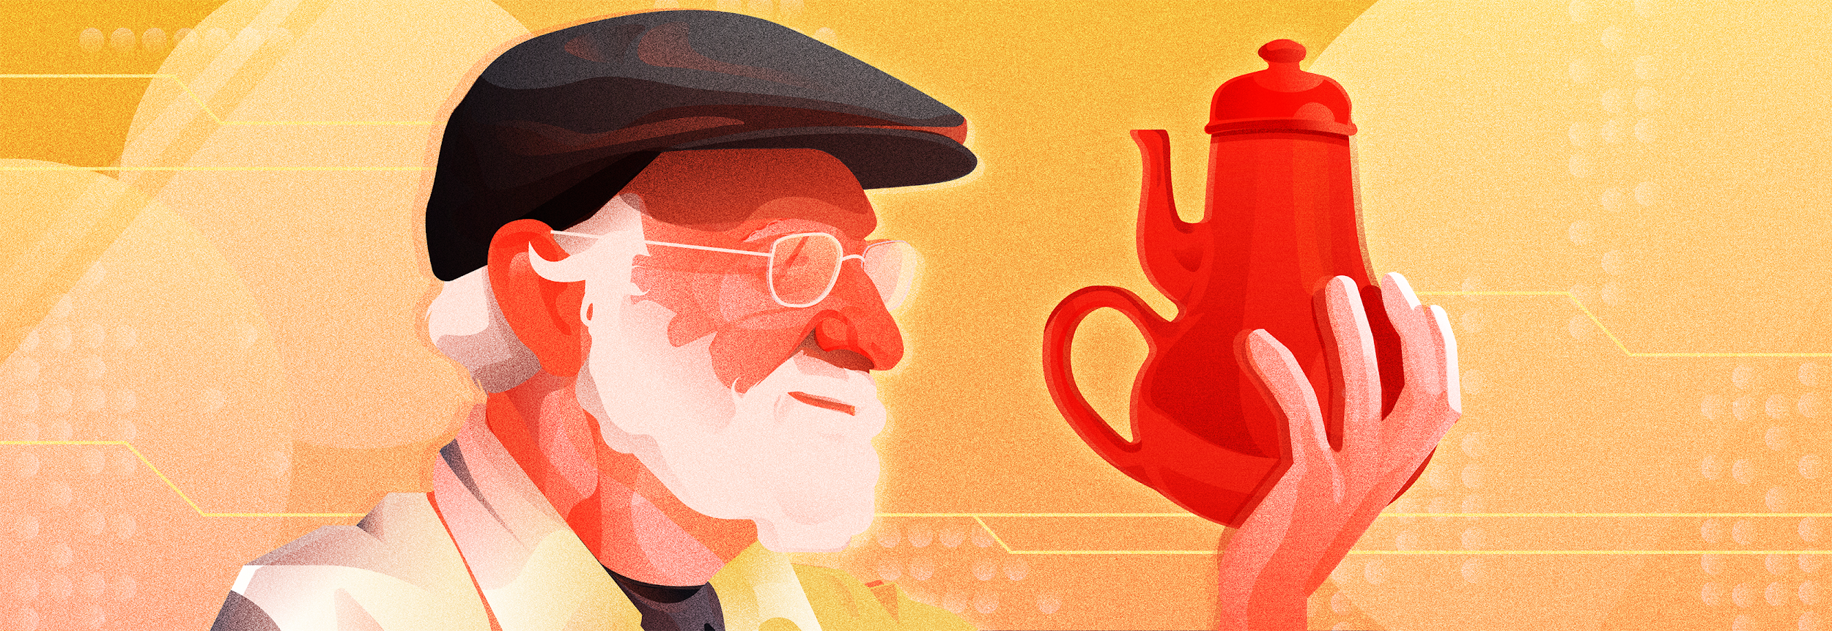
Don Norman - The New Business Of Growing Old - Fast Company article
"I wrote the book on user-friendly design. What I see today horrifies me."
The Design of Everyday Things by Don Norman, 1988
Illustration by Zachary Monteiro

Slide 39
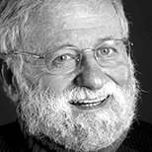
Don Norman, 84
Do not think that thoughtful design is just for the elderly, or the sick, or the disabled.
In the field of design, this is called “inclusive design” for a reason: It helps everyone.
Fast Company - The New Business Of Growing Old

Slide 40
Inclusive Design
is a field of User Experience Design that embraces how diverse people are beyond architecture and disabilities.

Slide 41
Microsoft Inclusive Design Principles
1
Recognize Exclusion
Designing for inclusivity not only opens up our products and services to more people, it also reflects how people really are.
All humans grow and adapt to the world around them and we want our designs to reflect that.

Slide 42
Microsoft Inclusive Design Principles
2
Solve for one, extend to many
Everyone has abilities, and limits to those abilities.
Designing for people with permanent disabilities actually results in designs that benefit people universally.
Constraints are a beautiful thing.

Slide 43
Microsoft Inclusive Design Principles
3
Learn from diversity
Human beings are the real experts in adapting to diversity. Inclusive design puts people in the center from the very start of the process, and those fresh, diverse perspectives are the key to true insight.

Slide 44
Inclusive Design Cycle
Recognize Exclusion
1
Learn from diversity
Solve for one, extend to many
3
2

Slide 45


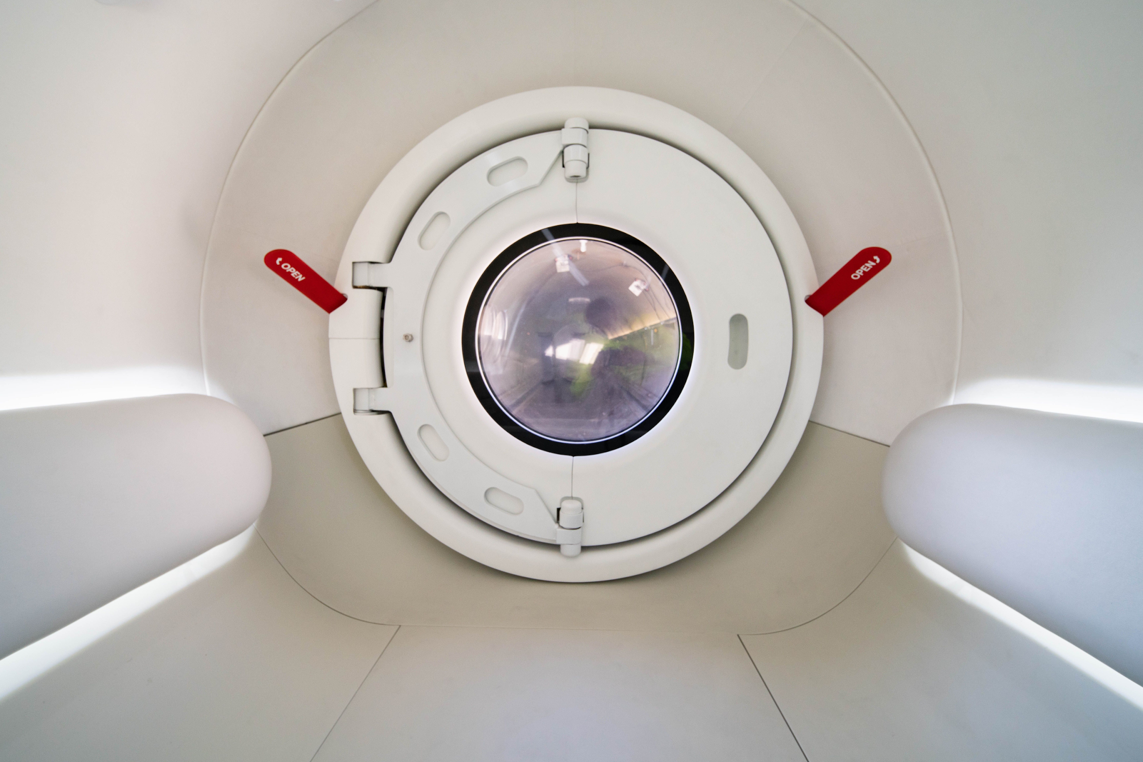
Revisiting Hyperloop:
Learning from a more inclusive approach

Slide 46
Inclusive Design Case for the Hyperloop
1
Recognize Exclusion
Include people with disabilities (wheelchair users) in leadership
2
Solve for one, extend to many
Design entry points and test loads with most difficult use cases
3
Learn from diversity
Learn from diverse ability sets

